Slide 1
Project Initiation
The Project Initiation Phase is the first phase in the project management lifecycle as defined by the PMBOK® Guide (Project Management Body of Knowledge).
This phase is crucial because it lays the foundation for the entire project.
Purpose: To define a new project or a new phase of an existing project by obtaining authorization to start the project.
Objective: Formally authorizes the project.
Key Inputs: Business case, agreements, enterprise environmental factors (EEFs), organizational process assets (OPAs).
Key Outputs: Project Charter.
Key Activities:
Define project goals and scope
Identify stakeholders
Develop a business case
Select the project using evaluation methods
Create a Project Charter

Slide 2
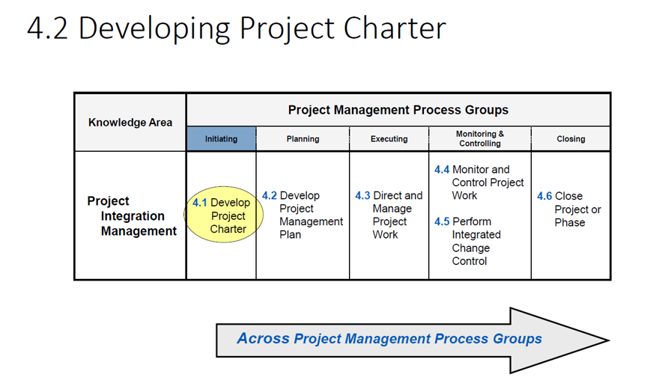

Slide 3
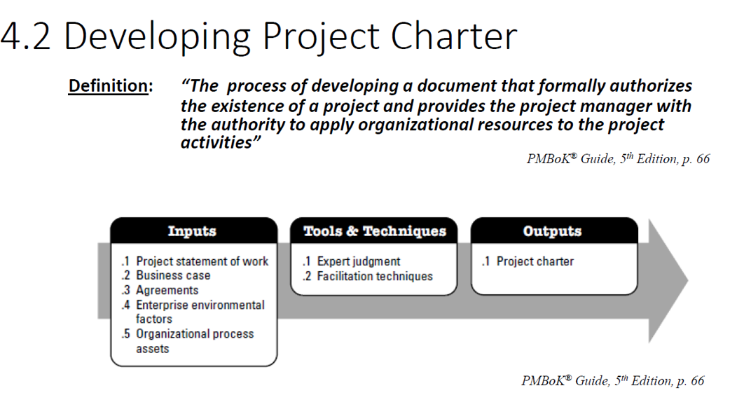

Slide 4
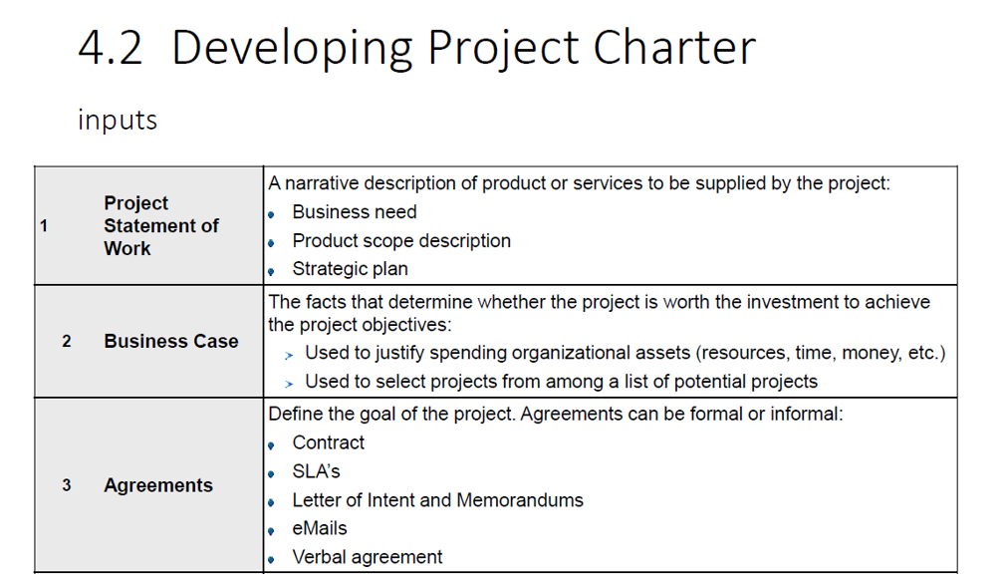

Slide 5
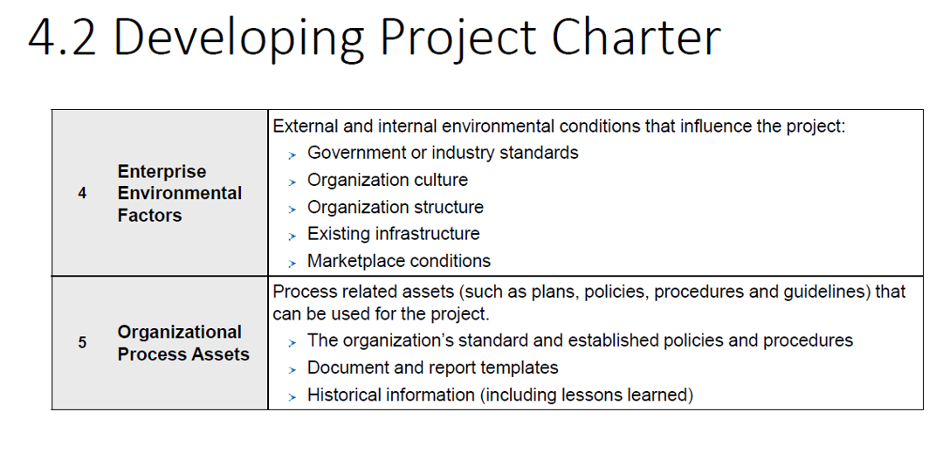

Slide 6
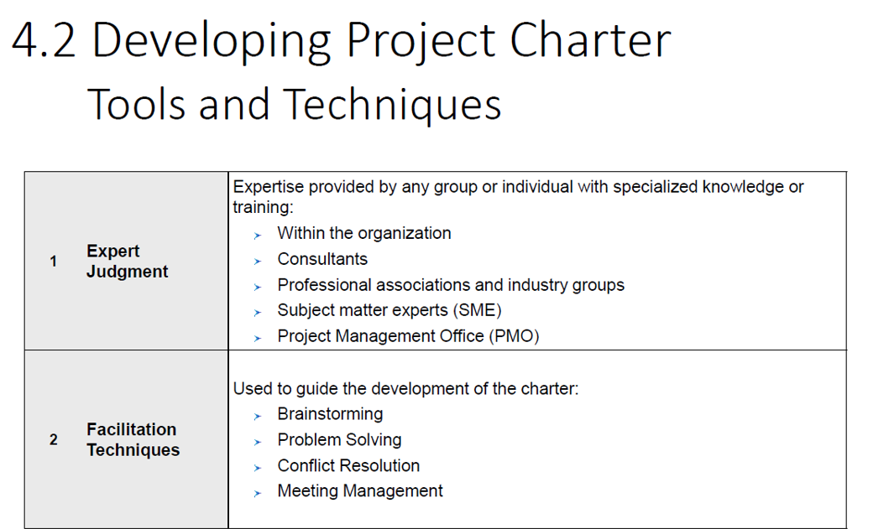

Slide 7
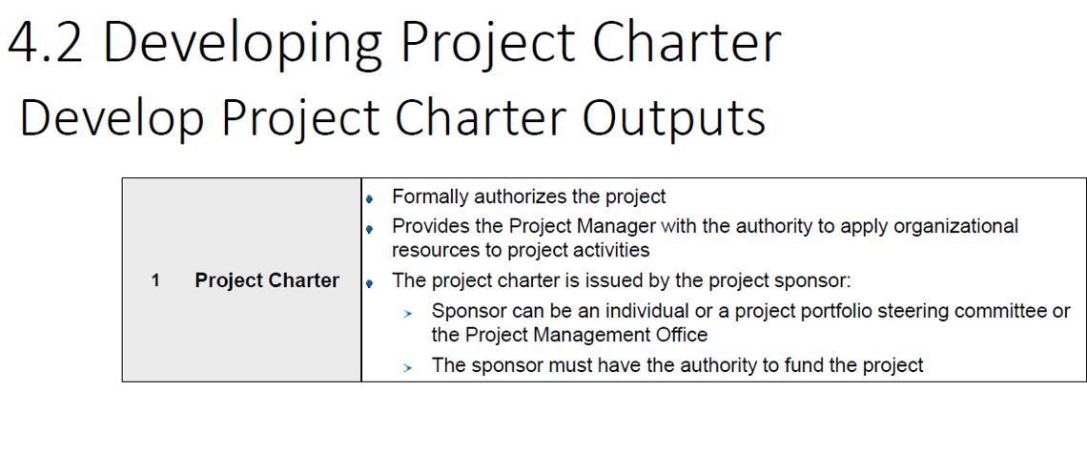

Slide 8
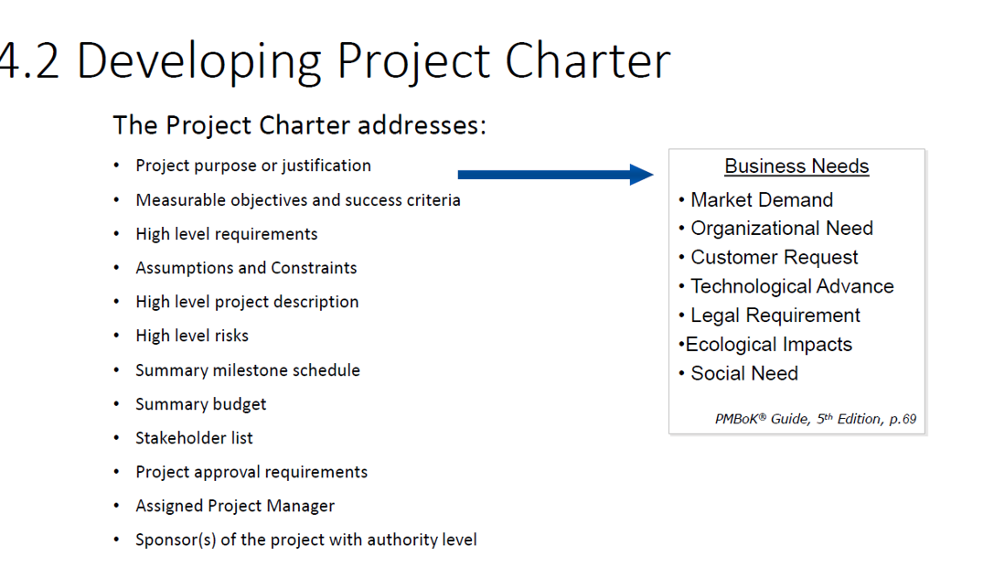

Slide 9
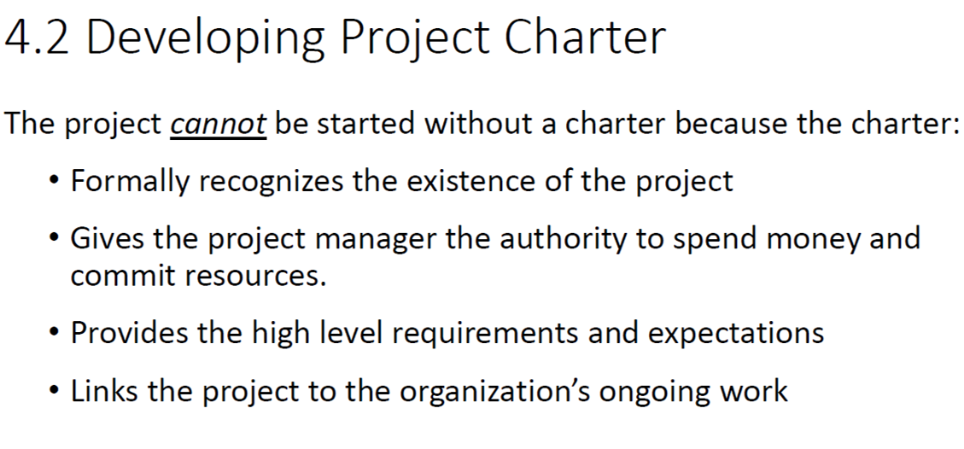

Slide 10
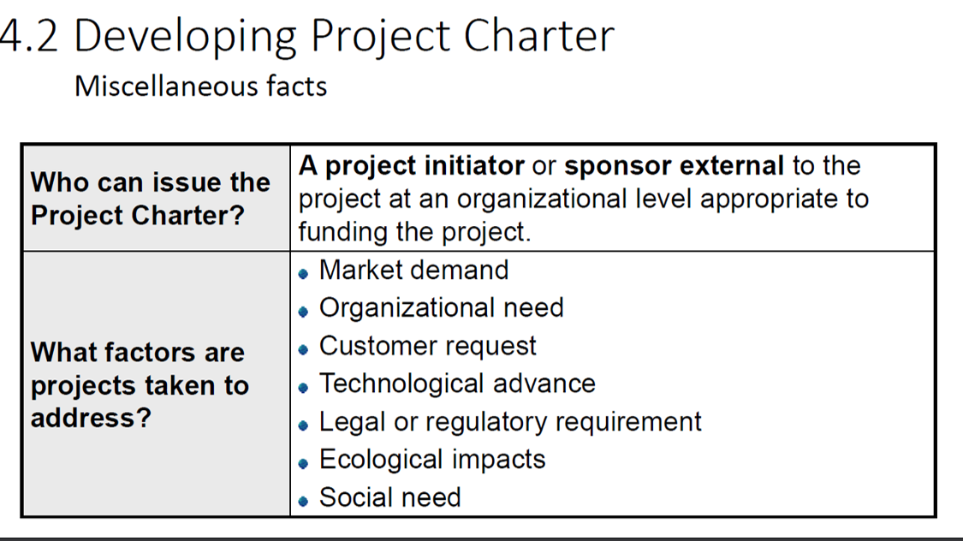

Slide 11
Develop Project Charter
A Project Charter is a formal document that authorizes the project, defines its objectives, and assigns the project manager.
It acts as a high-level roadmap and agreement between stakeholders and the project team.
Why is a Project Charter Needed?
Authorization: Officially starts the project and gives the project manager authority to use resources.
Clarity: Defines the project's purpose, scope, and goals.
Alignment: Ensures all stakeholders are on the same page.
Reference: Serves as a baseline for decision-making and conflict resolution.

Slide 12
Importance of a Project Charter
Benefit | Description
Defines Scope | Prevents scope creep by clearly stating what is and isn’t included.
Identifies Stakeholders | Lists key individuals and their roles.
Sets Objectives | Aligns the team with measurable goals.
Establishes Authority | Empowers the project manager to lead and make decisions.
Provides High-Level Timeline and Budget | Helps in early planning and resource allocation.

Slide 13
Typical Components of a Project Charter
Project Title and Description
Business Case
Objectives
Scope (Inclusions/Exclusions)
Key Stakeholders
Project Manager and Authority Level
High-Level Timeline and Budget
Risks and Assumptions

Slide 14
Project Charter: Mobile App Development
Project Title
ABC Tech Mobile App Development
Project Sponsor
Mr. Suman Thapa – Chief Technology Officer
Project Manager
Ms. Rina Joshi – Senior IT Project Manager
Purpose / Business Case
ABC Tech aims to enhance customer engagement and service accessibility by launching a mobile application. The app will allow users to manage accounts, receive notifications, access support, and interact with services on-the-go.

Slide 15
Project Charter: Mobile App Development
Objectives
Develop a cross-platform mobile app (iOS and Android)
Integrate with existing backend systems (CRM, billing)
Ensure secure login and data encryption
Launch MVP within 4 months
Scope
In Scope:
UI/UX design
Core features: login, dashboard, notifications, support chat
Integration with backend APIs
App store deployment
Out of Scope:
Web portal redesign
Advanced analytics and AI features

Slide 16
Project Charter: Mobile App Development
Key Stakeholders
Name | Role
Suman Thapa | Sponsor
Rina Joshi | Project Manager
Mobile Dev Team | Developers
QA Team | Testers
UI/UX Designers | Designers
Marketing Team | Launch and promotion
End Users | Customers

Slide 17
Milestones
Milestone | Target Date
Requirements Finalized | Aug 1, 2025
Design Approval | Aug 15, 2025
MVP Development Complete | Oct 15, 2025
UAT & Feedback | Oct 25, 2025
App Store Submission | Nov 1, 2025
Go-Live | Nov 10, 2025

Slide 18
Project Charter …
Budget Estimate
NPR 3,500,000 – Includes design, development, testing, and deployment.
Risks and Assumptions
Risks:
App store approval delays
API integration issues
Device compatibility challenges
Assumptions:
Backend systems are stable and accessible
Development team has required tools and skills
Stakeholders are available for feedback

Slide 19
Project Charter: College Management System
Project Title
Integrated College Management System for EduSmart Pvt. Ltd.
Project Sponsor
Mr. Prakash Adhikari – Managing Director, EduSmart Pvt. Ltd.
Project Manager
Ms. Nisha Shrestha – IT Project Manager, ABC Tech Solutions
Purpose / Business Case
EduSmart Pvt. Ltd. seeks to digitize and streamline its academic and administrative operations by implementing a comprehensive College Management System. The system will manage student records, faculty data, course scheduling, fee payments, and reporting.

Slide 20
Project Charter: College Management System
Objectives
Develop a centralized web-based system for college operations.
Automate student admissions, attendance, grading, and fee management.
Provide role-based access for students, faculty, and administrators.
Launch the system within 5 months with full functionality
Scope
In Scope:
Student registration and profile management
Course and timetable scheduling
Attendance and grading modules
Fee tracking and payment gateway integration
Admin dashboard and reporting tools
Out of Scope:
Mobile app development
Integration with external learning platforms (e.g., Moodle)

Slide 21
Project Charter: College Management System
Key Stakeholders
Name | Role
Prakash Adhikari | Sponsor
Nisha Shrestha | Project Manager
Development Team | Software Engineers
QA Team | Testers
College Admin Staff | End Users
Faculty Members | Contributors
Students | End Users

Slide 22
Project Charter: College Management System
Milestones
Milestone | Target Date
Requirements Gathering | Aug 1, 2025
System Design Approval | Aug 20, 2025
Development Phase Complete | Oct 30, 2025
Testing & UAT | Nov 15, 2025
Training & Deployment | Dec 1, 2025
Go-Live | Dec 10, 2025

Slide 23
Project Charter: College Management System
Budget Estimate
NPR 4,000,000 – Includes design, development, testing, deployment, and training.
Risks and Assumptions
Risks:
Delays in requirement finalization
Resistance to change from staff
Data migration challenges
Assumptions:
College staff will cooperate during training and testing
Required infrastructure (servers, internet) is available
Timely feedback from stakeholders

Slide 24
Identify Stakeholders
Objective: Identify all people or organizations impacted by the project and document relevant information.
Key Inputs: Project charter, business documents, EEFs, OPAs.
Key Outputs: Stakeholder register.
Includes:
Stakeholder names and roles
Interests, influence, and impact
Communication needs

Slide 25
Enterprise Environmental Factors (EEFs)
Enterprise Environmental Factors (EEF) are the conditions and influences—internal or external to the organization—that affect the project’s success.
These factors are not under the direct control of the project team but must be considered during planning and execution.Types of EEFs
Internal EEFs (within the organization):
Organizational culture, structure, and governance
Infrastructure (e.g., IT systems, facilities)
Resource availability (e.g., skilled staff, tools)
Internal policies, procedures, and standards
Employee capability and experience

Slide 26
Enterprise Environmental Factors (EEFs)
External EEFs (outside the organization):
Market conditions
Legal and regulatory environment
Industry standards
Political climate
Economic conditions
Social and cultural influences
Why EEFs Matter in Project Management
They influence how the project is planned and executed.
They can enable or constrain project decisions.
Project managers must adapt their strategies based on EEFs.

Slide 27
Example: EEF in an IT Project
Imagine you're an IT Manager leading a project to develop a mobile app for a college:
Internal EEFs:
The company uses Agile methodology.
Developers are skilled in Flutter and Firebase.
The organization has strict data security policies.
External EEFs:
Government regulations require student data protection.
The app must support multiple languages due to diverse student demographics.
The market trend favors mobile-first solutions.

Slide 28
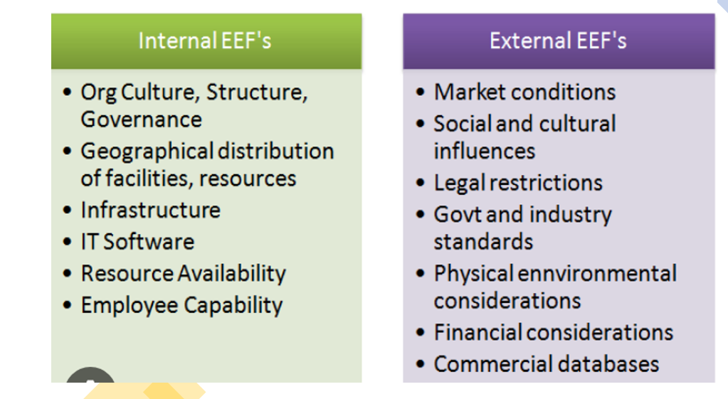

Slide 29
Organizational Process Assets (OPAs)
OPAs are plans, processes, policies, procedures, and knowledge bases specific to and used by the organization. These are internal assets that help manage projects.
Types of OPAs:
Processes, Policies, and Procedures
Templates (e.g., project charter, risk register)
Guidelines (e.g., coding standards)
Approval workflows
Change control procedures

Slide 30
Organizational Process Assets (OPAs)
Organizational Knowledge Repositories
Historical information (e.g., lessons learned from past projects)
Project files and documentation
Configuration management databases
Financial databases
Examples in an IT Company:
Project templates for agile sprints or waterfall phases.
Coding standards for Java or Python.
Lessons learned from previous software deployments.
Bug tracking systems like Jira or Azure DevOps.

Slide 31
EEF vs OPA
Category | EEF | OPA
Control | External/Internal, not controlled by project team | Internal, controlled by organization
Examples | Market trends, regulations, infrastructure | Templates, historical data, procedures
Impact | Constrains or influences project | Supports and guides project execution

Slide 32
Developing a Business Case
In the Project Initiation Phase, developing a Business Case is a critical step that justifies the need for the project and demonstrates its value to stakeholders.
According to the PMBOK® Guide, the business case is typically created before the project charter and is used to evaluate whether the project is worth pursuing.
A business case is a document or presentation that outlines:
Why the project is needed
What benefits it will deliver
How it aligns with organizational goals
What the costs, risks, and expected returns are

Slide 33
Key Components of a Business Case
Executive Summary
Brief overview of the project and its purpose
Problem/Opportunity Statement
What issue or opportunity is being addressed?
Analysis of Options
Possible solutions and why the proposed one is best
Project Description
Scope, objectives, and deliverables
Cost-Benefit Analysis
Estimated costs vs. expected benefits
Risk Assessment
Key risks and mitigation strategies
Recommendation
Why this project should be approved

Slide 34
Business Case: Development of a Food Ordering System
1. Executive Summary
The IT company proposes developing a food ordering system for restaurants and cloud kitchens to streamline order management, improve customer experience, and expand digital reach.
2. Problem Statement
Many small and mid-sized restaurants lack an integrated digital platform for managing online orders, leading to missed sales opportunities, inefficient operations, and poor customer engagement.
3. Options Considered
Option 1: Partner with third-party platforms (e.g., Uber Eats, Foodmandu)
Option 2: Build a custom food ordering system (recommended)
Option 3: Use open-source solutions with limited customization

Slide 35
Business Case: Development of a Food Ordering System
4. Project Description
Develop a web and mobile-based food ordering system with:
Customer-facing app for browsing menus, placing orders, and making payments
Admin dashboard for restaurants to manage orders, inventory, and analytics
Integration with payment gateways and delivery tracking
Support for promotional campaigns and loyalty programs
5. Cost-Benefit Analysis
Estimated Cost: $80,000 (design, development, testing, deployment)
Expected Benefits:
50% increase in direct online orders
30% reduction in order processing time
$100,000 projected annual revenue from licensing and subscriptions
Enhanced brand visibility and customer retention

Slide 36
Business Case: Development of a Food Ordering System
6. Risk Assessment
Risk: Low adoption by restaurants
Mitigation: Offer free trial and onboarding support
Risk: Technical issues during peak hours
Mitigation: Load testing and cloud-based scaling
7. Recommendation
Approve the development of the food ordering system to empower restaurants with digital tools, reduce dependency on third-party platforms, and create a scalable revenue stream for the company.

Slide 37
Define Project Goals
In the Project Initiation Phase as per the PMBOK® Guide, defining project goals and scope is essential to ensure clarity, alignment, and direction for the project.
These elements are typically captured in the Project Charter and further refined in the Scope Statement during planning.
Project goals are high-level statements that describe what the project aims to achieve. They should align with business objectives and provide a clear purpose.
Characteristics of Good Goals (SMART):
Specific
Measurable
Achievable
Relevant
Time-bound
Example (IT Project: Mobile Banking App)
Goal: Develop a secure and user-friendly mobile banking app to enable customers to manage accounts, transfer funds, and pay bills by Q4 2025.

Slide 38
Goals vs Objectives
Feature | Goals | Objectives
Definition | Broad, general intentions or desired outcomes | Specific, measurable steps to achieve a goal
Scope | High-level and strategic | Narrow and tactical
Timeframe | Long-term | Short- to medium-term
Measurability | Often not directly measurable | Clearly measurable and trackable
Focus | Vision-oriented | Action-oriented
Goals vs. Objectives: Key Differences

Slide 39
Goals are the "what" you want to achieve. Objectives are the "how" you will achieve it.
Examples
Business Context
Goal: Increase customer satisfaction.
Objective: Improve customer support response time from 24 hours to 6 hours within the next 3 months.
Software Development
Goal: Build a user-friendly mobile app.
Objective: Complete UI/UX design for the app by August 15th.
Education
Goal: Become fluent in Spanish.
Objective: Complete B2 level Spanish course and pass DELE exam by December.
Personal Development
Goal: Improve physical fitness.
Objective: Exercise 4 times a week for 30 minutes over the next 6 months.

Slide 40
SMART Goals
SMART goals are a framework used to set clear, achievable objectives. The acronym SMART stands for:
S – Specific
M – Measurable
A – Achievable
R – Relevant
T – Time-bound

Slide 41
SMART Goals
1. Specific
A goal should be clear and well-defined.
✅ Specific Example: “I want to increase my website traffic by 20% by publishing two blog posts per week.”
❌ Not Specific Example: “I want to improve my website.”
Why it matters: Specific goals eliminate ambiguity and help you focus your efforts.
2. Measurable
You should be able to track progress and know when the goal is achieved.
✅ Measurable Example: “I want to lose 5 kg in 3 months.”
❌ Not Measurable Example: “I want to get healthier.”
Why it matters: Measurable goals allow for tracking and motivation through progress.

Slide 42
SMART Goals
3. Achievable
The goal should be realistic given your resources and constraints.
✅ Achievable Example: “I will save $200 per month by cutting down on dining out.”
❌ Not Achievable Example: “I will become a millionaire in one month without any investment.”
Why it matters: Unrealistic goals can lead to frustration and failure.
4. Relevant
The goal should align with your broader objectives or values.
✅ Relevant Example: “I want to learn Python to improve my data analysis skills for my job.”
❌ Not Relevant Example: “I want to learn guitar even though I have no interest in music and it doesn’t help my career.”
Why it matters: Relevant goals keep you focused on what truly matters.
5. Time-bound
A goal should have a deadline or timeframe.
✅ Time-bound Example: “I will finish writing my thesis by October 30.”
❌ Not Time-bound Example: “I will write my thesis someday.”
Why it matters: Deadlines create urgency and help prioritize tasks.

Slide 43
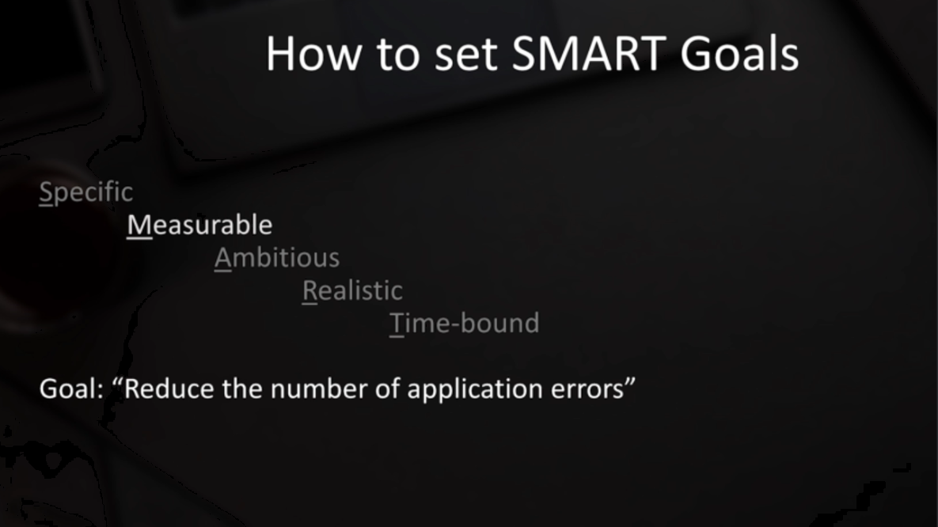

Slide 44
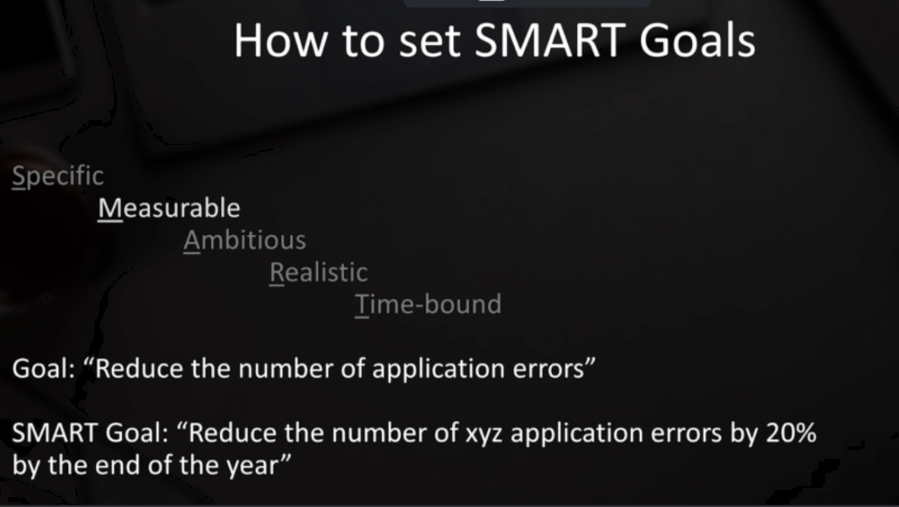

Slide 45
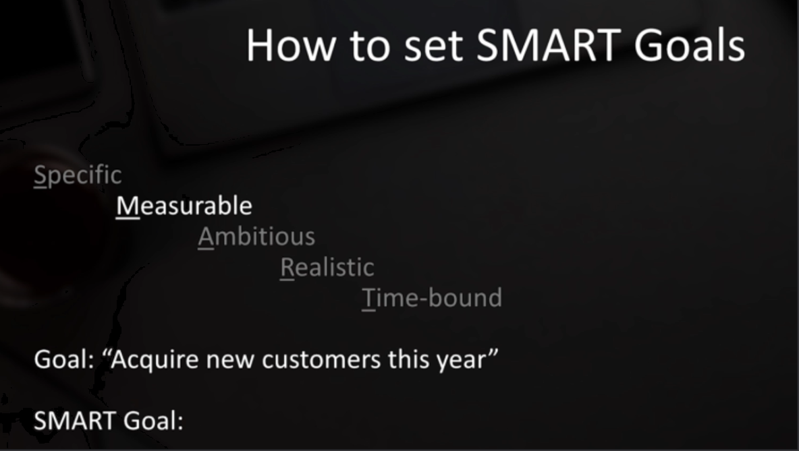

Slide 46
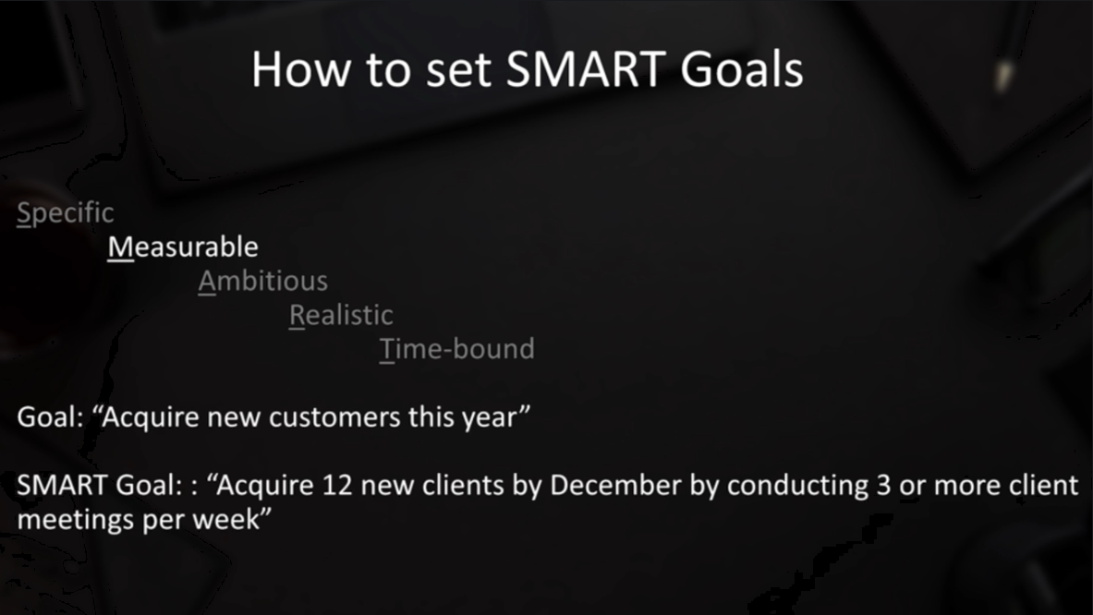

Slide 47
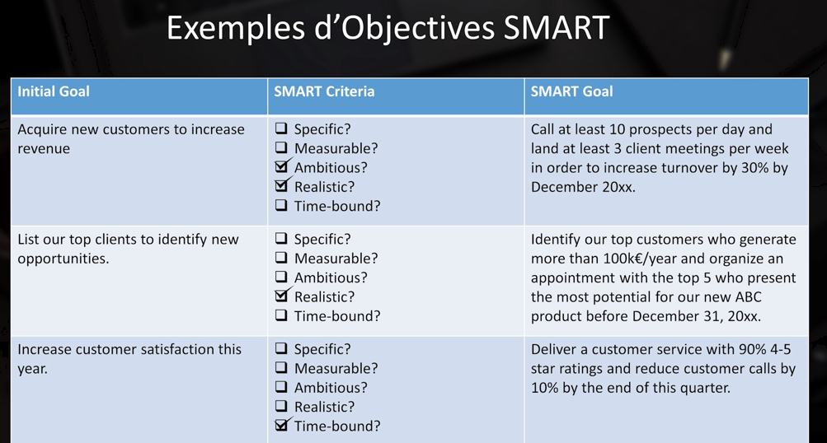

Slide 48
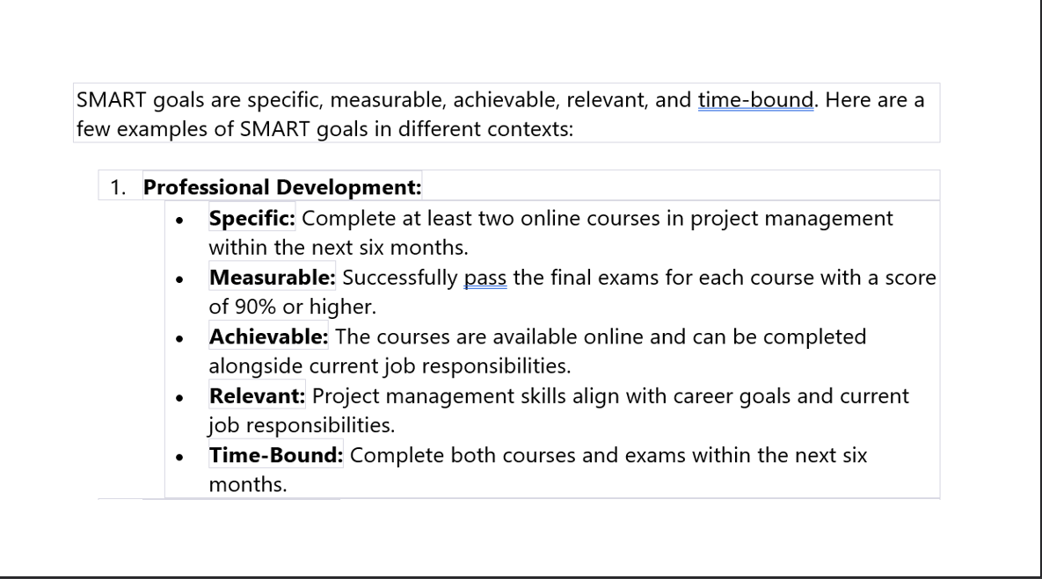

Slide 49
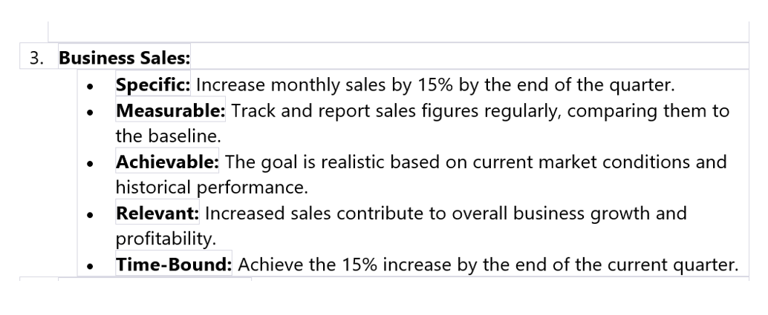

Slide 50
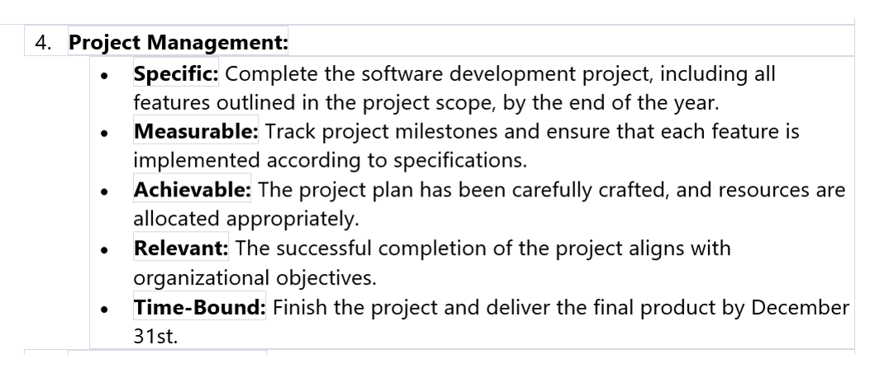

Slide 51
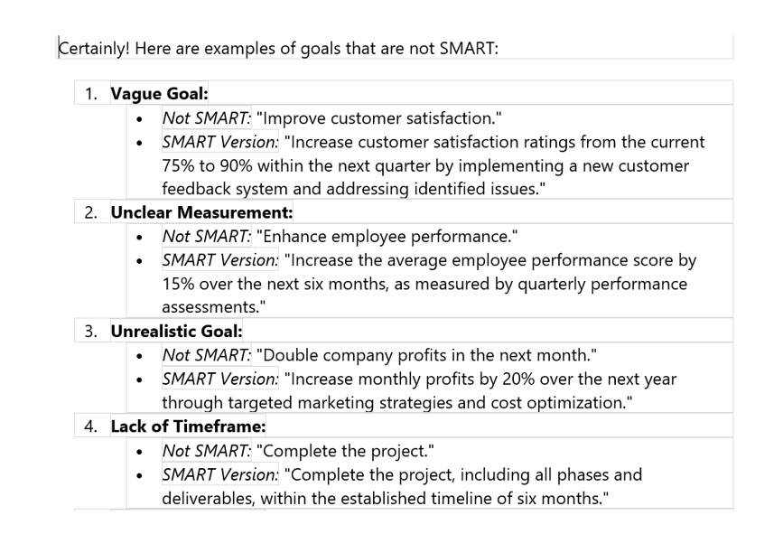

Slide 52
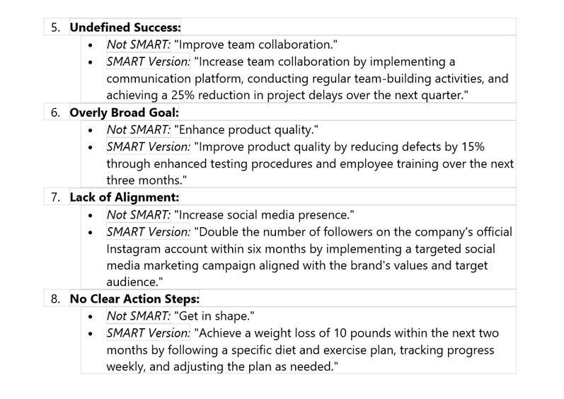

Slide 53
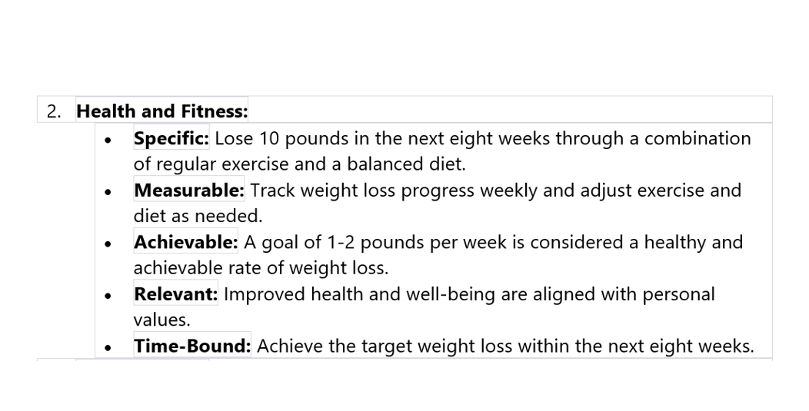

Slide 54
Defining project scope
Scope defines the boundaries of the project—what is included and what is excluded. It outlines the deliverables, features, and work required to complete the project.
➤ Scope Includes:
Inclusions: Features, functionalities, platforms
Exclusions: What will not be part of the project
Constraints: Time, budget, technology
Assumptions: Conditions assumed to be true

Slide 55
Example
Example (IT Project: Food Ordering System)
Scope Includes:
Development of mobile and web apps for customers
Admin dashboard for restaurants
Integration with payment gateways
Real-time order tracking
Scope Excludes:
Delivery logistics management
POS system integration
Constraints:
Budget capped at $80,000
Must be completed within 4 months
Assumptions:
Restaurants will provide menu data in standardized format

Slide 56
Project Selection
In the Project Initiation Phase, selecting the right project is crucial to ensure that resources are invested in initiatives that align with strategic goals and deliver value.
The PMBOK® Guide outlines several project selection methods that help organizations evaluate and prioritize projects objectively.
Why Are Project Selection Methods Needed?
To maximize ROI and strategic alignment
To prioritize among competing projects
To justify investment decisions
To reduce risk and improve resource allocation

Slide 57

Common Project Selection Methods
Net Present Value (NPV)
NPV is the difference between the present value of cash inflows and outflows over a project's lifetime. It helps determine whether a project will generate more value than it costs.
Net Present Value (NPV) is a financial metric used to evaluate the profitability of a project. It calculates the present value of expected future cash flows minus the initial investment.
Net Present Value (NPV) tells you how much money a project will make or lose, after considering the value of money over time.
“If I invest money in this project today, will I get more money back in the future—and how much more?”

Slide 58
Net Present Value
Where:
Rt​ = Net cash inflow during period tt
i = Discount rate
t = Time period
C0 = Initial investment
Decision Rule
If NPV > 0 → Accept the project (profitable)
If NPV < 0 → Reject the project (loss-making)
If NPV = 0 → Indifferent (break-even)
Example (IT Project: Cloud Migration)
Initial cost: $100,000
Expected annual savings: $30,000 for 5 years
Discount rate: 10%
If NPV > 0, the project is financially viable.

Slide 59
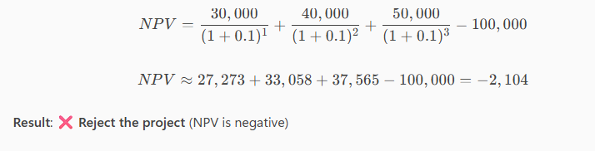
NPV
Example 1: Software Development Project
Initial Investment: $100,000
Expected Cash Inflows:
Year 1: $30,000
Year 2: $40,000
Year 3: $50,000
Discount Rate: 10%

Slide 60
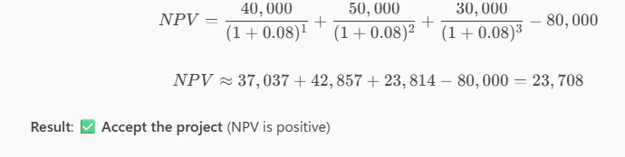
NPV
Initial Investment: $80,000
Expected Cash Inflows:
Year 1: $40,000
Year 2: $50,000
Year 3: $30,000
Discount Rate: 8%

Slide 61
NPV
You spend money now (investment).
You earn money later (future cash flows).
NPV calculates the value of those future earnings in today’s terms.
If the result is positive, the project is worth it.
If it’s negative, the project will lose money.
You invest $100,000 today.
You expect to earn:
$40,000 next year
$50,000 the year after
$30,000 in the third year
NPV calculates how much those future earnings are worth today.
If NPV = $20,000, it means:“After all costs and time value of money, I’ll gain $20,000.”

Slide 62
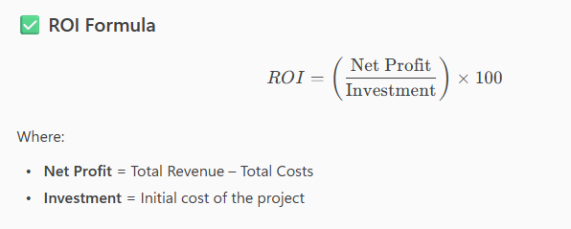
ROI – Return on Investment
Return on Investment (ROI) is a simple and widely used method to evaluate the profitability of a project. It shows how much return you get compared to what you invest.

Slide 63
ROI
Example 1: Mobile App Development
Investment: $100,000
Expected Revenue: $160,000
Net Profit = $160,000 – $100,000 = $60,000
ROI=60%
Good ROI – Project is profitable
Example 2: College Management System
Investment: $120,000
Expected Revenue: $150,000
Net Profit = $30,000
ROI=25%
Moderate ROI – May be acceptable depending on strategic value

Slide 64
ROI
🔹 Example 3: Cloud Migration Project
Investment: $80,000
Expected Revenue: $100,000
Net Profit = $20,000
ROI = 25%
Same ROI as Example 2, but lower investment – might be preferred if budget is limited

Slide 65
Scoring Models
Scoring models assign weights and scores to various criteria (e.g., strategic alignment, risk, ROI, customer impact) to rank projects.
A Scoring Model is a quantitative decision-making tool used to evaluate and compare multiple projects based on predefined criteria.
Each project is scored against these criteria, and the total score helps determine which project is the best fit.
Why Use Scoring Models?
Helps objectively compare projects
Considers multiple factors, not just financial
Useful when projects have strategic, technical, or operational goals
Steps:
Define evaluation criteria
Assign weights to each criterion
Score each project against criteria
Calculate total weighted score

Slide 66
Scoring Models
Step-by-Step Process:
Define Evaluation Criteria Examples: ROI, strategic alignment, risk, resource availability, customer impact
Assign Weights to Each Criterion Based on importance (e.g., ROI = 40%, Risk = 20%)
Score Each Project Against Each Criterion Use a scale (e.g., 1 to 10)
Calculate Weighted Scores Multiply score × weight for each criterion
Sum Total Scores The project with the highest total score is preferred

Slide 67
Scoring Models
Criteria | Weight | Mobile App Score | Web Portal Score
Strategic Alignment | 30% | 8 | 6
ROI | 25% | 7 | 9
Customer Impact | 25% | 9 | 7
Technical Feasibility | 20% | 6 | 8
Example (IT Project: Mobile App vs. Web Portal)

Slide 68
Scoring Models
Mobile App Total Score = (8×0.3)+(7×0.25)+(9×0.25)+(6×0.2) = 7.55 Web Portal Total Score = (6×0.3)+(9×0.25)+(7×0.25)+(8×0.2) = 7.55
In this case, both projects score equally, so other factors like urgency or resource availability may guide the final decision.

Slide 69
Project Scope, Objectives
➤ Definition:
The project scope outlines the boundaries of the project—what will be done and what will not be done. It includes the work required to deliver the product, service, or result.
➤ Key Elements:
Inclusions: What is part of the project
Exclusions: What is not part of the project
Constraints: Time, budget, resources
Assumptions: Conditions assumed to be true
➤ Example (IT Project: Online Learning Platform)
Inclusions: Web-based platform, user registration, course catalog, video streaming
Exclusions: Mobile app development, content creation
Constraints: Must be delivered in 6 months with a $100,000 budget
Assumptions: Instructors will upload their own content

Slide 70
Project Objectives
🔹 2. Project Objectives
➤ Definition:
Objectives are specific, measurable goals that the project aims to achieve. They guide the project team and help evaluate success.
➤ Characteristics (SMART):
Specific
Measurable
Achievable
Relevant
Time-bound
➤ Example (IT Project: CRM System)
Implement a CRM system to manage customer interactions
Reduce customer response time by 30% within 3 months
Increase lead conversion rate by 20% in the first quarter after launch

Slide 71
Project Deliverables
🔹 3. Project Deliverables
➤ Definition:
Deliverables are the tangible or intangible outputs produced as a result of the project. They are handed over to the client or stakeholders.
➤ Types:
Product Deliverables: Software, hardware, documents
Process Deliverables: Reports, plans, training materials
➤ Example (IT Project: Food Ordering App)
Mobile app (iOS and Android)
Admin dashboard for restaurants
API documentation
User manual and training guide

Slide 72
🔹 Difference Between Goals and Objectives
Feature | Goals | Objectives
Definition | Broad, general intentions of what is to be achieved | Specific, measurable steps to achieve the goal
Scope | High-level, strategic | Detailed, tactical
Focus | Vision and direction | Action and results
Timeframe | Long-term | Short- to medium-term
Measurement | Often qualitative | Always measurable

Slide 73
✅ Example (IT Project: E-commerce Website)
Goal: Improve online customer experience.
Objective: Launch a responsive e-commerce website with secure payment integration by December 2025.

Slide 74
🔹 SMART Objectives
SMART is an acronym that ensures objectives are well-defined and achievable.
Letter | Meaning | Description
S | Specific | Clearly defines what is to be achieved
M | Measurable | Quantifiable to track progress
A | Achievable | Realistic given resources and constraints
R | Relevant | Aligned with broader goals
T | Time-bound | Has a clear deadline

Slide 75
Non-SMART Objectives
These are vague, unmeasurable, or unrealistic, making them hard to track or achieve.
❌ Non-SMART Objective Example:
“Improve app performance soon.”
Why it’s not SMART:
Not specific (what aspect of performance?)
Not measurable (how much improvement?)
No timeline
No clear relevance or achievability

Slide 76
Stakeholders
Stakeholders are individuals, groups, or organizations that:
Affect or are affected by the project
Have interests, influence, or power over project decisions and outcomes
🔹 Types of Stakeholders
➤ Internal Stakeholders
Project Sponsor: Provides funding and support
Project Manager: Leads the project
Project Team Members: Execute tasks
Senior Management: Oversees strategic alignment
Functional Managers: Provide resources or expertise

Slide 77
Stakeholders
➤ External Stakeholders
Customers/Clients: End users of the product/service
Suppliers/Vendors: Provide goods or services
Regulatory Bodies: Ensure compliance
Partners: Collaborate on project delivery
Community/Public: May be impacted by the project

Slide 78
Identifying Stakeholders
This is done during the Initiation Phase using the Identify Stakeholders process.
➤ Tools & Techniques:
Stakeholder analysis
Interviews and surveys
Expert judgment
Document reviews
➤ Output:
Stakeholder Register: Contains names, roles, interests, influence, and engagement strategies

Slide 79
🔹 Stakeholder Engagement Strategies
➤ Based on Power-Interest Grid:
Stakeholder Type | Strategy
High Power, High Interest | Manage closely
High Power, Low Interest | Keep satisfied
Low Power, High Interest | Keep informed
Low Power, Low Interest | Monitor with minimal effort

Slide 80
Engagement Techniques:
Regular communication (meetings, emails, dashboards)
Involvement in decision-making
Feedback loops
Conflict resolution
Transparency and trust-building

Slide 81
🔹 Examples
✅ Example 1: IT Project – CRM System
Internal Stakeholders: Sales team, IT department, project sponsor
External Stakeholders: CRM vendor, customers
Engagement Strategy: Weekly demos for sales team, monthly updates to sponsor, vendor coordination meetings
✅ Example 2: Food Ordering App
Internal: Developers, marketing team, product owner
External: Restaurant partners, payment gateway providers, end users
Engagement Strategy: Surveys for users, onboarding sessions for restaurants, sprint reviews for internal teams

Slide 82
Stakeholder Register
A Stakeholder Register is a formal document that lists all project stakeholders along with relevant information about their roles, interests, influence, and engagement strategies.
Why Is It Needed?
To ensure effective communication and engagement
To manage expectations and influence
To identify potential risks or support
To align stakeholders with project goals
To serve as a reference for planning and decision-making

Slide 83
Stakeholder Register
Components of a Stakeholder Register
Here are the typical components with examples from an IT project (e.g., CRM system implementation):
Component | Description | Example
Stakeholder Name | Full name or group name | Priya Sharma (Sales Manager)
Role/Position | Their role in or relation to the project | End user, sponsor, developer
Contact Information | Email, phone, location | priya.sharma@company.com
Interest | What they care about in the project | Wants better lead tracking and reporting
Influence | Level of impact on project decisions | High (can approve/reject features)
Power | Authority over resources or decisions | Medium (can allocate team members)
Engagement Level | Current and desired level of involvement | Current: Passive; Desired: Supportive
Communication Needs | Preferred method and frequency of communication | Weekly email updates and monthly review meetings

Slide 84
Key Stakeholder Engagement Strategies
1. Identify Stakeholder Needs and Interests
Understand what each stakeholder cares about—whether it's cost, quality, timeline, or impact.
Example: In a mobile app development project, the marketing team may be interested in user engagement features, while the finance team focuses on budget control.

Slide 85
Key Stakeholder Engagement Strategies
2. Classify Stakeholders (Power-Interest Grid)
Stakeholder Type | Strategy
High Power, High Interest | Manage closely
High Power, Low Interest | Keep satisfied
Low Power, High Interest | Keep informed
Low Power, Low Interest | Monitor with minimal effort

Slide 86
3. Tailor Communication
Use the right channels, frequency, and tone based on stakeholder preferences.
Example:
Executives: Monthly dashboards and strategic updates
Team members: Daily stand-ups and task boards
Clients: Weekly progress emails and demos
4. Involve Stakeholders in Decision-Making
Engage stakeholders in planning, reviews, and feedback sessions to increase buy-in.
Example: In a food ordering system, restaurant partners can be invited to test early prototypes and suggest UI improvements.

Slide 87
5. Manage Expectations
Set realistic goals, clarify scope, and communicate changes proactively.
Example: If a feature is delayed, inform stakeholders early and explain the impact and mitigation plan.

Slide 88
6. Monitor Engagement Levels
Use tools like the Stakeholder Engagement Assessment Matrix to track current vs. desired engagement levels.
Stakeholder | Current Level | Desired Level | Strategy
Sponsor | Supportive | Leading | Involve in key decisions
Users | Unaware | Supportive | Conduct training and demos

Slide 89
